Slide 1
Her Ride
For woman by woman
Agile Product Management Capstone Project
By- Ahana Podder

Slide 2
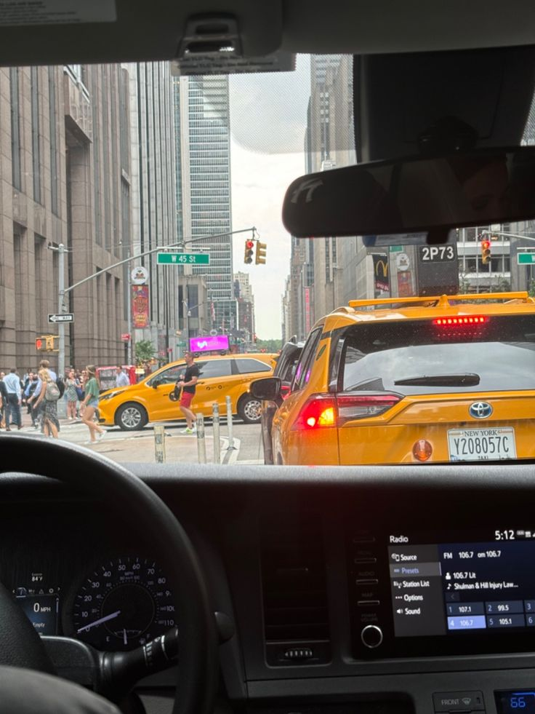
Introduction
In a bustling world, Her Ride emerges as a beacon of safety and empowerment for women. This innovative app is designed with a singular focus: to provide a secure and reliable transportation solution nationwide, driven by women, for women. Our mission is to foster a community where every journey is undertaken with confidence and peace of mind, enhancing mobility and independence for countless individuals across India.
At its core, Her Ride addresses the critical need for a trusted travel option. We aim to revolutionize urban commuting by prioritizing safety, comfort, and empowerment for both riders and drivers. Through intuitive design and robust features, we're not just offering rides; we're building a movement towards safer, more inclusive transportation. Join us as we redefine what it means to travel freely and confidently.

Slide 3
Problem Statement
Women in many cities face safety concerns, harassment risks, and discomfort while using traditional ride-sharing platforms, especially at night or in less-crowded areas. Despite high demand for mobility, the lack of women-only transport options limits their freedom, job opportunities, and participation in the workforce.
Key pain points:
Safety concerns during travel (especially late hours).
Lack of trust in existing ride-sharing platforms.
Few women drivers available.
Limited reporting or emergency mechanisms that truly work.
Social discomfort with male drivers.

Slide 4


Persona
Rider Persona: Aisha Sharma
Aisha, a vibrant 28-year-old marketing professional in Mumbai, often dedicates long hours to her ambitious career. However, her evenings are frequently shadowed by the persistent worry of finding safe and reliable transport home. She prioritizes her personal safety above all else, craving a service that not only offers convenience and dependability but also grants her profound peace of mind, allowing her to fully immerse herself in her professional aspirations without a moment's fear.
Goals
Achieve career ambitions and professional growth.
Maintain independence and control over her schedule.
Enjoy peace of mind knowing her commute is safe and reliable.
Pain Points
Constant worry about personal safety during commutes, especially at night.
Frustration with unreliable and unpredictable transportation services.
Wasted time waiting for rides, impacting work-life balance.
Driver Persona: Priya Devi
Priya, a resilient 45-year-old mother of two from Delhi, is an experienced driver driven by the desire to provide for her family. She actively seeks a flexible income source that offers not just fair pay, but also genuine respect and a safe, empowering working environment. Her dedication and reliability are unwavering, as she eagerly contributes to her family's well-being, all while feeling secure and supported on every journey.
Goals
Ensure financial stability and provide for her family's needs.
Gain respect and recognition for her professional driving skills.
Work in a safe, supportive, and empowering environment.
Pain Points
Income instability and unpredictable earnings from current opportunities.
Exposure to unsafe working conditions and lack of security.
Lack of fair treatment in male-dominated transportation sectors.

Slide 5
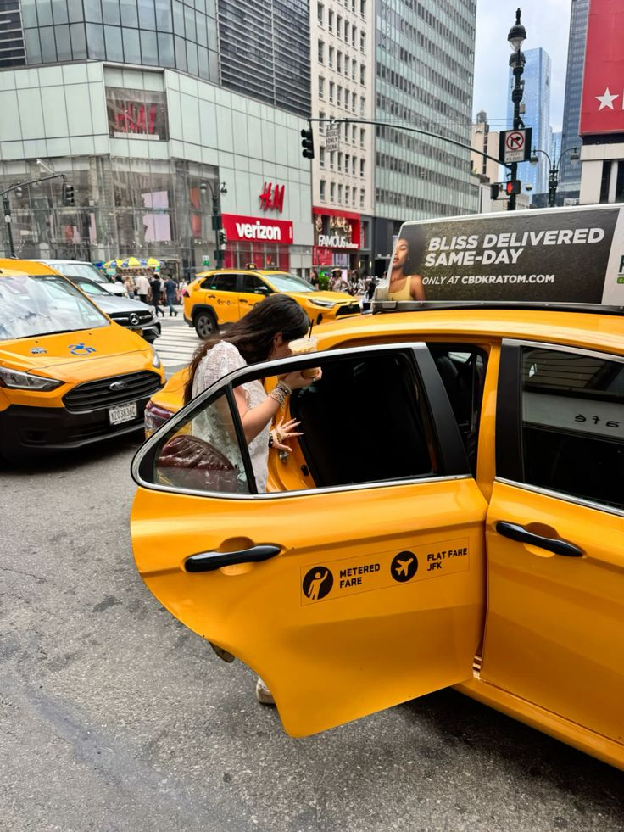
Vision
Her ride aims to transform women’s mobility in India by building a transportation ecosystem where safety, dignity, and empowerment are non-negotiable. Our mission is to enable every woman—students, professionals, mothers, and travelers—to move confidently at any hour, without fear or hesitation.
We strive to create a women-driven network that not only offers secure and reliable rides but also empowers women drivers with meaningful livelihood opportunities. By combining safety-focused technology, trust-centered design, and a supportive community, her ride seeks to redefine urban travel and contribute to a more inclusive, equitable society where mobility becomes a gateway to independence and economic growth for all women.

Slide 6
Product market fit
Levers | Key Assumptions | High-Level Requirements | Plan in Discovery
Lever 1: Safety & Trust Women repeatedly emphasized safety as their top priority. Trust in the platform and the driver is the decisive factor for adoption. | Women will shift to a new ride service only if it provides a safer, more trusted environment than existing apps. A women-driven model increases perceived and actual safety. Real-time emergency features are expected, not optional. | Women-only driver onboarding (ID verification, police verification). Real-time ride tracking with SOS integrated with emergency contacts. Driver behavior ratings and transparent profiles. | Conduct shadow interviews of women commuters and female drivers. Prototype emergency UI flows and test reactions to ensure clarity and usability under stress. Validate willingness to choose female drivers even at a slightly higher fare.
Lever 2: Reliability & Service Quality Women want predictable, clean, and comfortable rides—issues often missing in current services. | Clean, well-maintained vehicles significantly improve trust and perceived safety. Women prefer predictable ETAs and assured availability during peak hours or late nights. Transparent pricing reduces anxiety and builds loyalty. | Vehicle check standards and periodic inspections. Cleanliness score and incentives for high-scoring drivers. Guaranteed ride availability in hotspot areas through fleet planning. Clear pricing structure and fare transparency. | Field tests on hygiene perception: show vehicle photos and gather trust scores. Pilot “Preferred Driver” matching to evaluate repeat usage. Explore partnerships for vehicle maintenance benefits for female drivers.
Lever 3: Emotional Connection & Empowerment Her Ride isn’t just a utility—it's a community-driven movement empowering women to support women. | Women value being part of a platform that uplifts other women. Female drivers want a supportive, safe work environment. Social impact messaging increases retention and loyalty. | Driver community programs (training, peer support, financial literacy workshops). “Support Women Drivers” badges and storytelling within the app. Driver benefits such as insurance, training, and flexible schedules. | Interview existing female drivers from other platforms to understand barriers. Test in-app empowerment storytelling to measure emotional resonance. Evaluate willingness of users to pay slightly more for women-led services.
Lever 4: Convenience & User Experience The app must offer seamless usability—women prefer simple, fast interfaces. | A clean, intuitive design increases trust and reduces hesitation during emergencies. Women expect features tailored to their lifestyle (share ride status, preferred drivers, discreet mode). | One-tap SOS button with voice activation. Instant booking with accurate tracking. Simple, non-cluttered UI with high contrast and minimal steps. | Rapid prototyping of key screens and usability tests with women across age groups. Evaluate effectiveness of SOS button placement and ride-sharing flow. Conduct A/B tests for first-time user onboarding experience.
Lever 5: Pricing, Sustainability & Scale To ensure long-term success, the model must balance affordability with high service quality and fair earnings for women drivers. | Users are willing to pay a small premium for guaranteed safety. Female drivers require competitive earnings and incentives to join. Scaling requires partnerships and city-by-city expansion. | Tiered pricing (Standard Safe Ride / Premium Safe Ride with verified drivers). Incentive programs for women drivers during peak hours. Strategic collaborations with corporates, colleges, and events. | Test willingness-to-pay models. Conduct small-city pilots to measure adoption. Validate driver acquisition costs and earning potential.

Slide 7
Requirements design
1. Business requirements (high-level)
These come directly from user interviews, the problem statement, and product-market fit levers.
Br1. Ensure women’s safety during travel
Women want guaranteed safety in all situations, especially late nights.
Br2. Build trust through women-only driver network
Women strongly prefer female drivers for comfort and trust.
Br3. Deliver clean, reliable & comfortable rides
Reliable etas, clean cars, and professional behavior heavily influence adoption.
Br4. Provide emergency support & real-time monitoring
Women expect immediate, accessible help in emergencies.
Br5. Enable empowerment & economic opportunity for women drivers
The platform must attract and support female drivers with training, community, and earnings transparency.
Br6. Offer a simple, intuitive, stress-free user experience
Ease of use and minimal cognitive load during travel is critical.

Slide 8
Requirements design
2. Technology requirements (high-level)
Tr1. Secure driver verification system
Aadhar-based KYC
Police verification
Document uploads
Background check workflow
Tr2. Real-time ride tracking & telemetry
GPS-based live tracking
Driver location accuracy
Ride replay visibility
Geofencing alerts
Tr3. Emergency response architecture
One-tap SOS
Integration with emergency contacts
Auto-trigger events (e.g., Long stop, route deviation)
Panic mode backend workflows
Tr4. Clean & maintainable app architecture
Scalable microservices
High-availability backend
Encrypted data storage
Secure authentication (OAuth, JWT)
Tr5. UI/UX optimized for safety & speed
Large, accessible emergency button
Preferred driver algorithm
Two-tap ride booking flow
Reliability-first design system

Slide 9
Requirements design
How requirements map to charter
Charter Pillar | Mapped Requirement | Why It Fits
Safety-first | BR1, TR3, TR2 | Ensures physical & psychological safety
Women-driven mobility | BR2, BR5, TR1 | Builds trust, empowers women drivers
Trust & transparency | BR3, TR1, TR2 | Verified drivers, reliable tracking
Reliability & comfort | BR3, TR4, TR6 | Makes daily commuting predictable and comfortable
Inclusive empowerment | BR5, TR5 | Supports women drivers & community building

Slide 10
Product backlog
EPIC 1: User Safety & Trust
User Story | Description | Acceptance criteria
Safety-001 | As a rider, I want an SOS button so I can trigger emergency help instantly. | SOS must notify trusted contacts + backend safety response system.
Safety-002 | As a rider, I want my ride to be tracked live so I feel safer. | Real-time GPS visible to rider + trusted contacts.
Safety-003 | As a rider, I want only verified women drivers. | Driver KYC + gender verification mandatory before activation.
EPIC 2: Ride Booking & Core Mobility
User Story | Description | Acceptance criteria
Ride-001 | As a rider, I want to request a ride easily. | Pickup → drop → fare → confirm flow built.
Ride-002 | As a rider, I want to see my driver’s details before the ride. | Driver photo, name, rating, vehicle number visible.
Ride-003 | As a driver, I want to accept or reject ride requests. | Driver app shows requests + swipe-to-accept option.
Ride-004 | As a user, I want ETA and distance calculation. | Display based on maps integration.

Slide 11
Product backlog
EPIC 3: Payments & End-to-End Completion
User Story | Description | Acceptance criteria
Pay-001 | As a rider, I want basic fare calculation. | Transparent estimated fare before confirming ride.
Pay-002 | As a rider, I want to pay conveniently. | UPI and cash payment support.
Pay-003 | As a rider, I want a ride receipt after completion. | Receipt sent via app + SMS/email.
EPIC 4: Profiles & Verification
User Story | Description | Acceptance criteria
Profile-001 | As a rider, I want OTP login. | OTP via SMS + secure session.
Profile-002 | As a driver, I want to upload documents for verification. | License, Aadhaar, vehicle docs upload.
Profile-003 | As a rider, I want to add trusted contacts. | Minimum 1 emergency contact required.

Slide 12
Product backlog
EPIC 5: Notifications & Communication
User Story | Description | Acceptance criteria
Notif-001 | As a rider, I want notifications for ride status. | Notifications for driver arrival, ride start, ride end.
Notif-002 | As a user, I want trip alerts sent to my trusted contacts. | SMS/push when ride begins.
EPIC 6: Support & Quality
User Story | Description | Acceptance criteria
Support-001 | As a user, I want basic in-app support. | FAQs + issue reporting.
Support-002 | As a rider, I want to rate drivers. | 1–5 star rating after trip.

Slide 13
MoSCoW prioritization
Category | Features | Why It Belongs Here?
MUST Have | - SOS & Emergency Contact Alerts - Women-Only Driver Verification - Ride Booking Flow (pickup → drop) - Live GPS Tracking - Driver App (Accept/Reject) - Basic Pricing Engine - OTP Login & Profile Setup | Core value: Safety + Trust + Basic Mobility. Without these, the product cannot solve the core problem.
SHOULD Have | - In-App Payments (UPI) - Trip History - Driver Ratings & Reviews - Push Notifications - Ride Cancellation Flow | Important for reliability and user retention, but not essential for confirming PMF within MVP.
COULD Have | - Promo Codes / Referrals - Driver Incentives Dashboard - Scheduled Rides - Comfort/Cleanliness Tags | Enhances user experience and competitiveness; not mandatory for early learning.
WON’T Have (For now) | - Carpooling - Multi-stop Trips - Subscription Plans - In-app Chat - Community Features | High complexity, not core to MVP, and can distract from initial safety-first vision.

Slide 14
User Flow- Driver
Sign-up & Verification
Driver downloads app
Registers with phone number
Uploads documents:
  Aadhaar
  Driving license
  Vehicle RC
  Background check consent
Verification team reviews
Driver attends safety onboarding session
Driver Dashboard
Online/Offline toggle
Requests screen
Wallet earnings
Trip history
Navigation settings
Help & Support
Ride Request
Driver receives ride request
Sees pickup location
Accepts or rejects
Navigate to Pickup
Built-in navigation to rider location
Call/Chat rider if needed (masked number)
“Arrived” button on reaching
Start Ride
Confirm rider identity
Start trip
Turn-by-turn navigation
Safety options visible (SOS, emergency contact)
Complete Ride
End trip
Fare auto-calculated
Rider makes payment
Driver sees earning added to wallet

Slide 15

User Flow- Rider
Onboarding
Download app → Open → “Get Started”
Mobile OTP verification
Fill profile (name, photo optional, age)
Add emergency contacts
Accept permissions (location, notifications)
Home Screen
Access to trip history and payment details
Map + “Book Ride”
User selects her ride: Solo or Shared
SOS button visible
Booking a Ride
Enter pickup
Enter destination
App shows: Fare estimate, Ride type (Solo or Shared), ETA
User confirms ride
Ride request goes to nearby women drivers
Driver Assignment
Driver accepts → App shows driver profile (photo, ratings, vehicle number, ride count)
Live tracking begins
User can: Call (masked), Chat
Ride Experience
Driver arrives → Notification: “Your driver is here”
Trip starts
Rider sees: Live navigation, SOS, Share location, In-ride support
Trip Completion
Driver ends trip
Fare displayed
Payment through UPI/Wallet/Cash
Digital invoice sent

Slide 16
Outcome-Based Roadmap
Outcomes | Features | Priority | Success metrics
Outcome 1: Increase Rider’s Sense of Safety by 50% | SOS Emergency Button (Immediate dispatch + live location) Real-Time Ride Tracking (shared with trusted contacts) Verified Women Driver System | HIGH | Safety perception score increases from baseline to 8.5/10 % of rides with live tracking shared ≥ 60% Verified driver ratio = 100% women drivers
Outcome 2: Build Trust in Drivers & Platform | Driver Safety Badge + Background Check Status Driver Training & Safety Orientation Pre-Ride Identity Confirmation (Driver + Vehicle) | HIGH | Trust score improves to 8+/10 Incidents per 10,000 rides < 1 Driver onboarding rejection rate > 30% (shows strict quality)
Outcome 3: Reduce Ride Cancellations by 30% | Smart Driver-Rider Matching Algorithm Cancellation Shield (protect rider time) Accurate ETA Prediction Engine | HIGH | Ride cancellation rate drops by 30% Average wait time < 6 minutes ETA accuracy ≥ 85%
Outcome 4: Improve Comfort & Cleanliness Experience | Comfort Rating System (Cleanliness, behaviour) Driver Incentives for High Comfort Scores Vehicle Condition Checklist (weekly) | MEDIUM | Average comfort rating ≥ 4.7/5 Vehicle cleanliness complaints reduced by 50% Drivers earning bonuses ≥ 20% (behaviour improvement)
Outcome 5: Increase Driver Retention to 70% | Driver Earnings Dashboard 2.0 Weekly Goal Rewards Women Driver Skill Workshops (Driving + Safety) | MEDIUM | Driver retention increases to 70% Avg driver earnings/hour increases by 20% Training completion rate ≥ 85%
Outcome 6: Enable More Women to Join as Drivers | Car Leasing / Rent-to-Own Program Zero-interest Microloan Partnerships Community Support Groups | LOW–MEDIUM | New driver acquisition grows by 40% % of drivers without personal vehicle ≥ 30% onboarded Loan repayment rate ≥ 90%
Outcome 7: Optimize Payments & Reduce Operational Leakage | UPI Payment Integration (fast, secure) Dynamic Pricing Engine | MEDIUM | Payment failure rate < 1% Successful transaction rate > 98% Revenue leakage reduced by 25%

Slide 17
MVP Timeline
Phase | Timeline | Objectives | Core Features (Prioritized for Max Value & Learning) | Expected Outcomes
Phase 1: Foundations & Validation | Week 1–2 | Validate user needs and core problem-solution fit | • User Registration (Phone/Email) • Basic Rider Profile • Secure Login • Safety Settings (Emergency Contact) | • Confirm demand and core usability • Establish baseline safety expectations
Phase 2: Core Ride Booking MVP | Week 3–5 | Enable women to reliably book safe rides | • Location Search (Pickup/Drop) • Ride Request Flow • Driver Matching (Prototype) • Fare Estimate (Basic) | • Users can request and complete rides • Identify key friction points
Phase 3: Safety & Trust Layer | Week 6–7 | Build essential trust to drive early adoption | • SOS Button • Live Trip Tracking • Verified Women Drivers • Driver Rating & Review | • Increased rider confidence • Reduce early churn
Phase 4: Payments & Efficiency | Week 8–10 | Improve end-to-end experience & retention | • In-App Payments (UPI/Card) • Trip History • Ride Cancellation Flow • Basic Customer Support Flow | • Reduced drop-offs at payment stage • Improved repeat rides
Phase 5: Learning & Optimization | Week 11–12 | Analyze validated learning and iterate | • Bug Fixes & Performance Enhancements • Journey Optimization • Early A/B Tests • Metrics Dashboard (Internal) | • Clear direction for Version 2.0 • Prioritized backlog for next release

Slide 18
Business model canvas
Customer Segments
Daily commuters
Students
Night-shift employees
Women riders
Drivers seeking stable earnings
Customer Characteristics
Safety-focused
Price-sensitive
Prefer digital payments
Expect transparency & reliability
Customer Journey
1) Open app → 2) Enter pickup/drop → 3) View fare → 4) Book → 5) Track ride → 6) Pay → 7) Rate
Value Proposition
Safe & reliable rides
Transparent pricing
Women-first safety features
Smooth payments
Corporate travel solutions
Revenue Streams
Ride commissions
Surge revenue
Subscriptions
Corporate transport billing
Financial KPIs
Take Rate (% commission per ride)
Cost per Acquisition (CAC)
Customer Lifetime Value (CLTV)
Monthly Active Riders (MAR)
Trip Success Rate
Revenue per Trip
Gross Margin
Driver Utilization Rate
Key Partners
UPI/Card payment gateways
Map & routing providers
KYC/verification vendors
Corporate employers
Insurance partners
Key Activities
Driver onboarding
Matching & routing
Safety monitoring
App & backend development
Customer/driver support
Pricing Model
Base fare + km/min pricing
Surge multipliers
SafePass subscription
B2B monthly billing
Cost Structure
Cloud & map API costs
Support & operations team
Driver incentives
Marketing & acquisition
Compliance & insurance
Key Resources / IP
Matching algorithm
Routing + ETA engine
Safety & SOS stack
Operations dashboards
Driver scoring models
Risks / Concerns
Strong competition
Driver churn
Safety incidents
Regulatory caps
Map API cost spikes

Slide 19
User feedback integration
What | Simple Explanation
How We Collect Feedback | Ask for rating after every ride Let users choose quick reasons (e.g., “Driver was polite”, “Cab was late”) Allow short comments Small surveys sometimes Support messages from chat/email App Store reviews
How Feedback Is Organized | All feedback stored in one place Grouped by type: bugs, design issues, safety, driver behavior
How Feedback Goes Into Development | Safety issues sent to Operations team immediately Repeated problems added to upcoming sprints Developers fix highest-impact issues first
How We Improve Continuously | Weekly review of top complaints Fix repeated issues quickly Use feedback to help drivers improve Update app features where users struggle Inform users when improvements are made

Slide 20
Sprint planning
Sprint | Timeline | Epic | User Story | Tasks | Story Points | Dependencies
S1 | Week 1-2 | Rider Onboarding | Rider sign-up via mobile OTP | UX flow → UI screens → FE OTP → BE validation → QA | 5 | None
S1 | Week 3-5 | Rider Onboarding | Create rider profile | UX fields → UI design → FE form → BE save → QA | 3 | OTP sign-up
S1 | Week 6-8 | Rider Onboarding | Edit personal details | UI states → FE update → QA | 3 | Profile creation
S2 | Week 8-10 | Ride Booking & Tracking | Select pickup & drop location | UX flow → UI inputs → FE location logic → QA | 5 | Rider logged in
S2 | Week 11-13 | Ride Booking & Tracking | View fare estimate | UI fare component → FE display → QA | 3 | Pickup & drop selected
S2 | Week 14-16 | Ride Booking & Tracking | Confirm ride request | UI confirm → FE request → BE handling → QA | 5 | Fare estimate

Slide 21
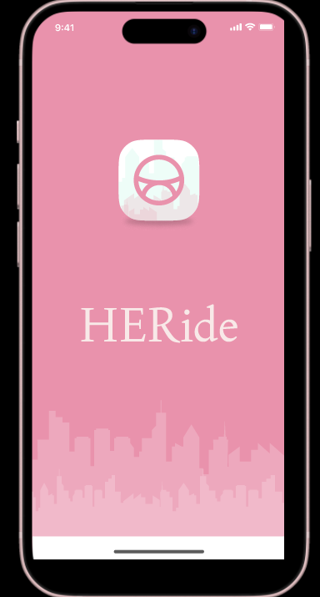
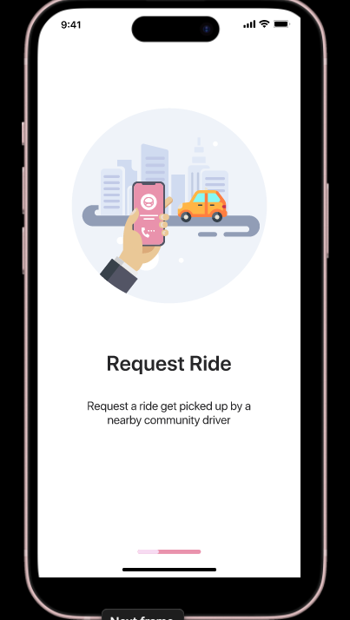
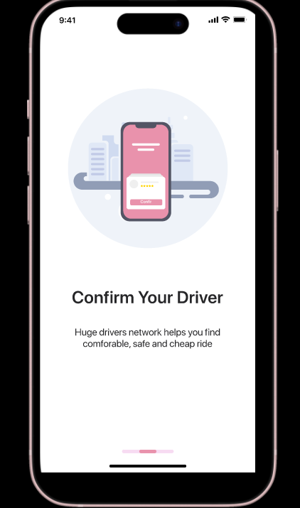
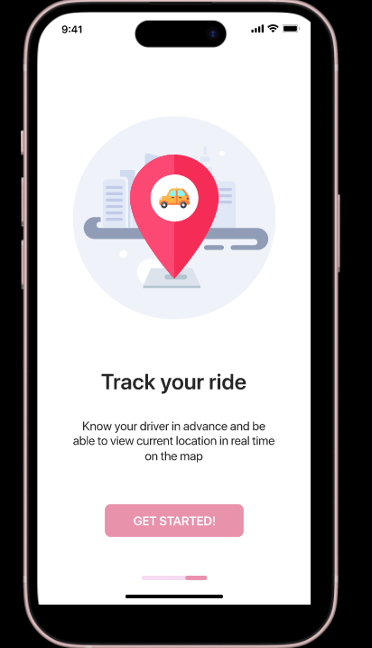
Mockups

Slide 22
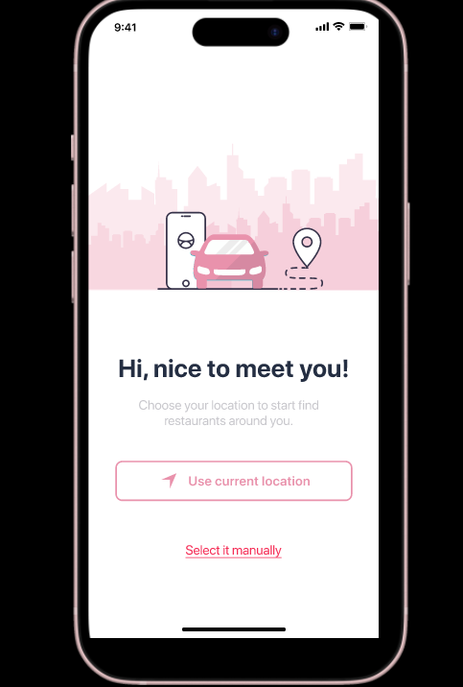
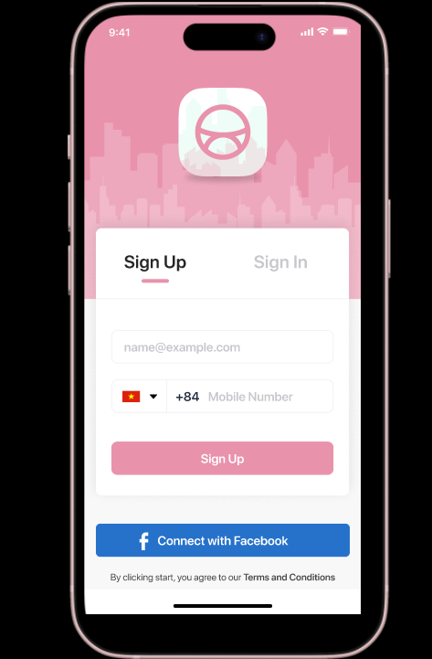
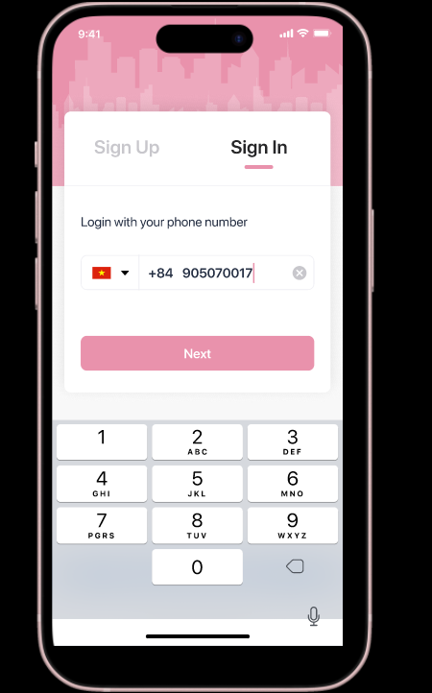
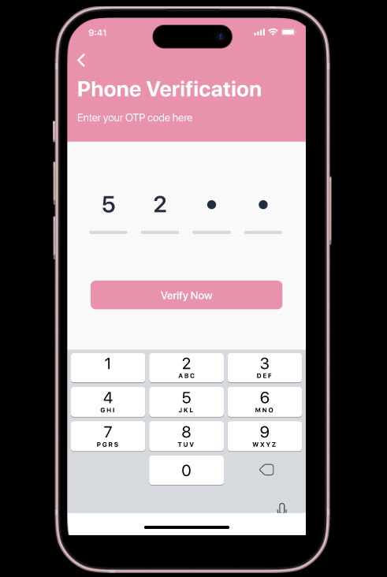
Mockups

Slide 23
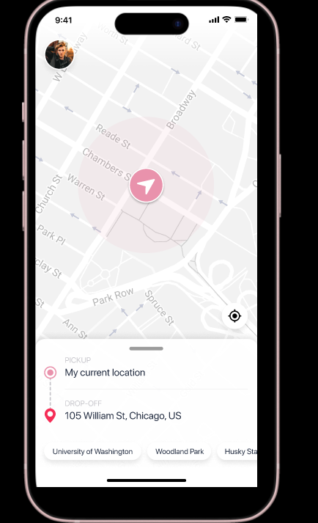
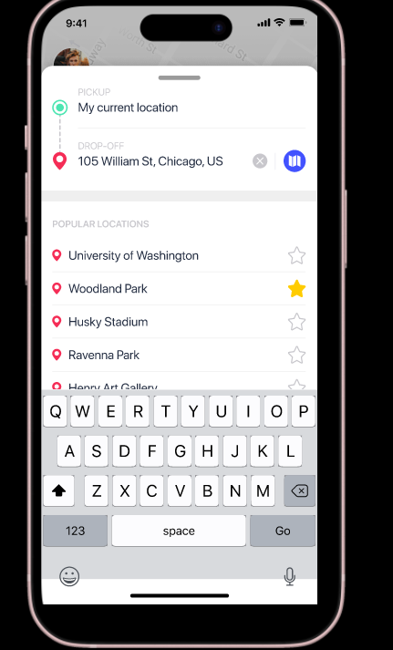
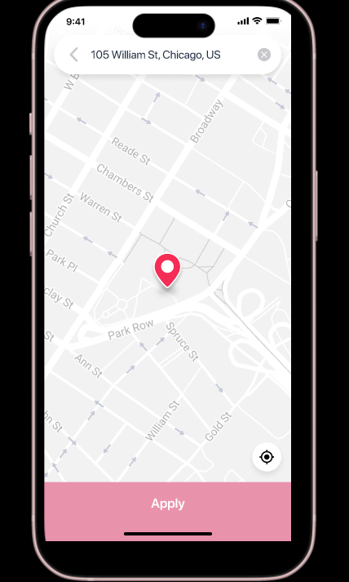
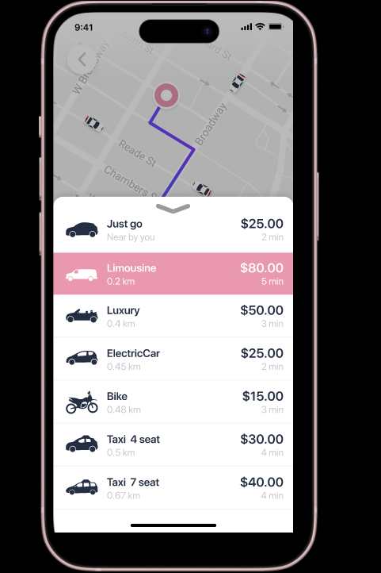
Mockups

Slide 24
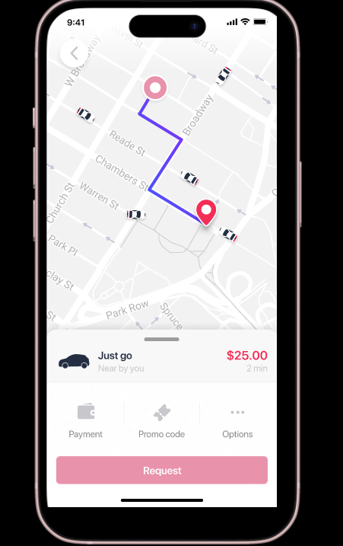
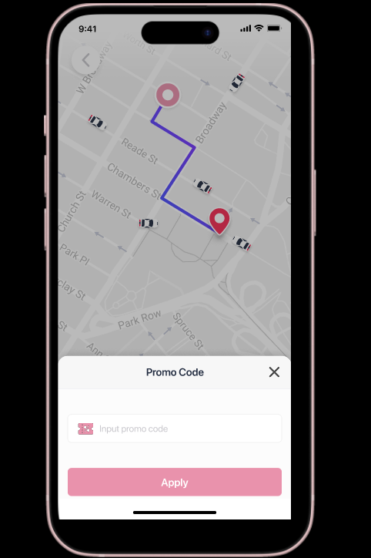
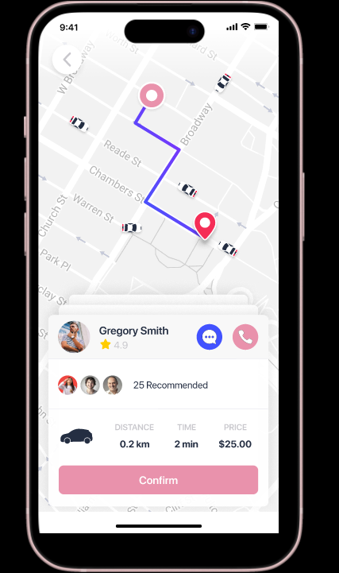
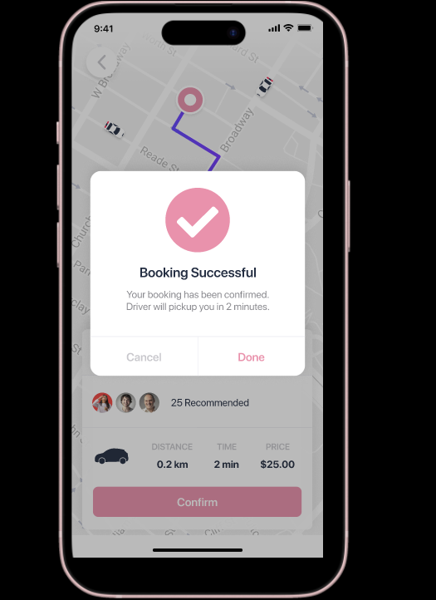
Mockups

Slide 25
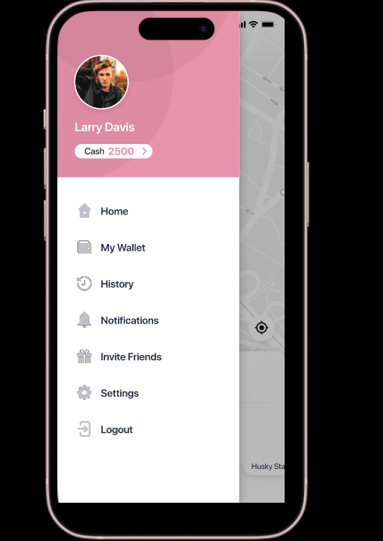
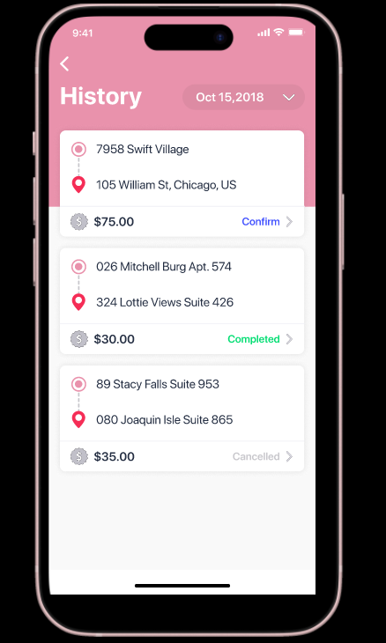
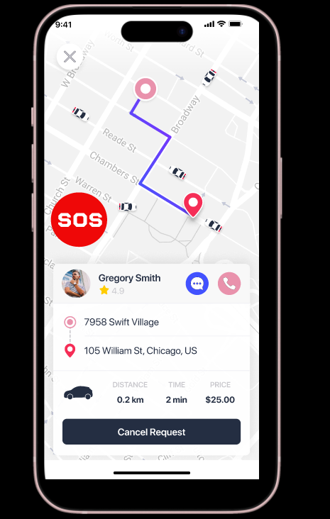
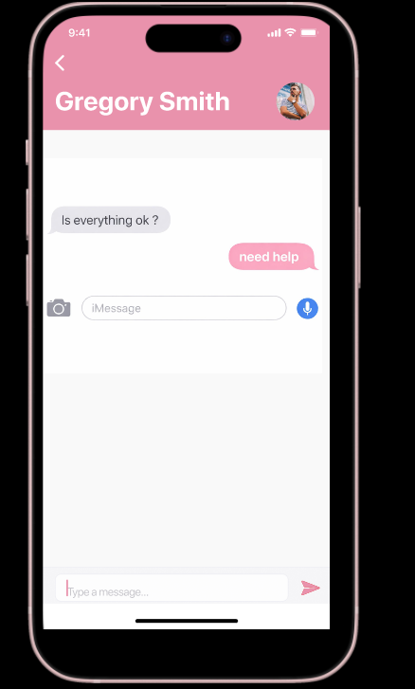
Mockups

Slide 26
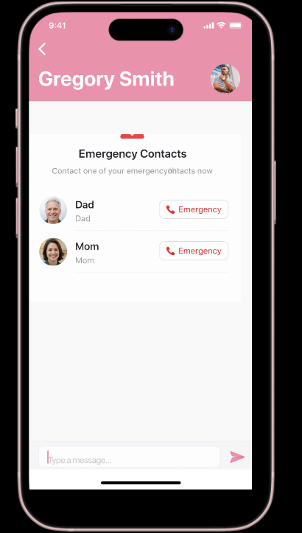
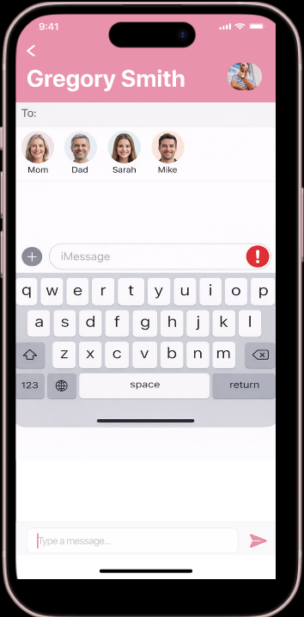
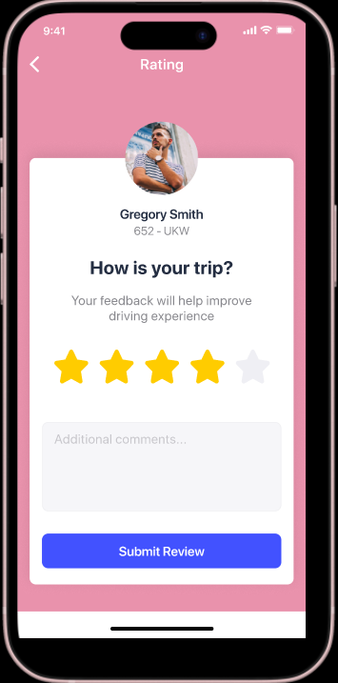
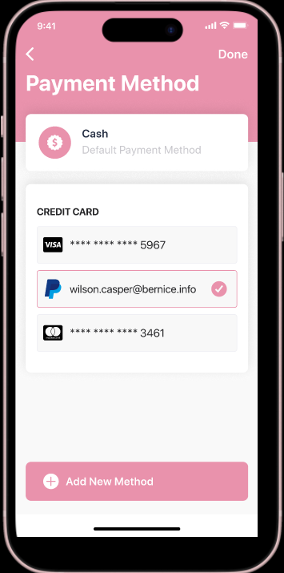
Mockups

Slide 27
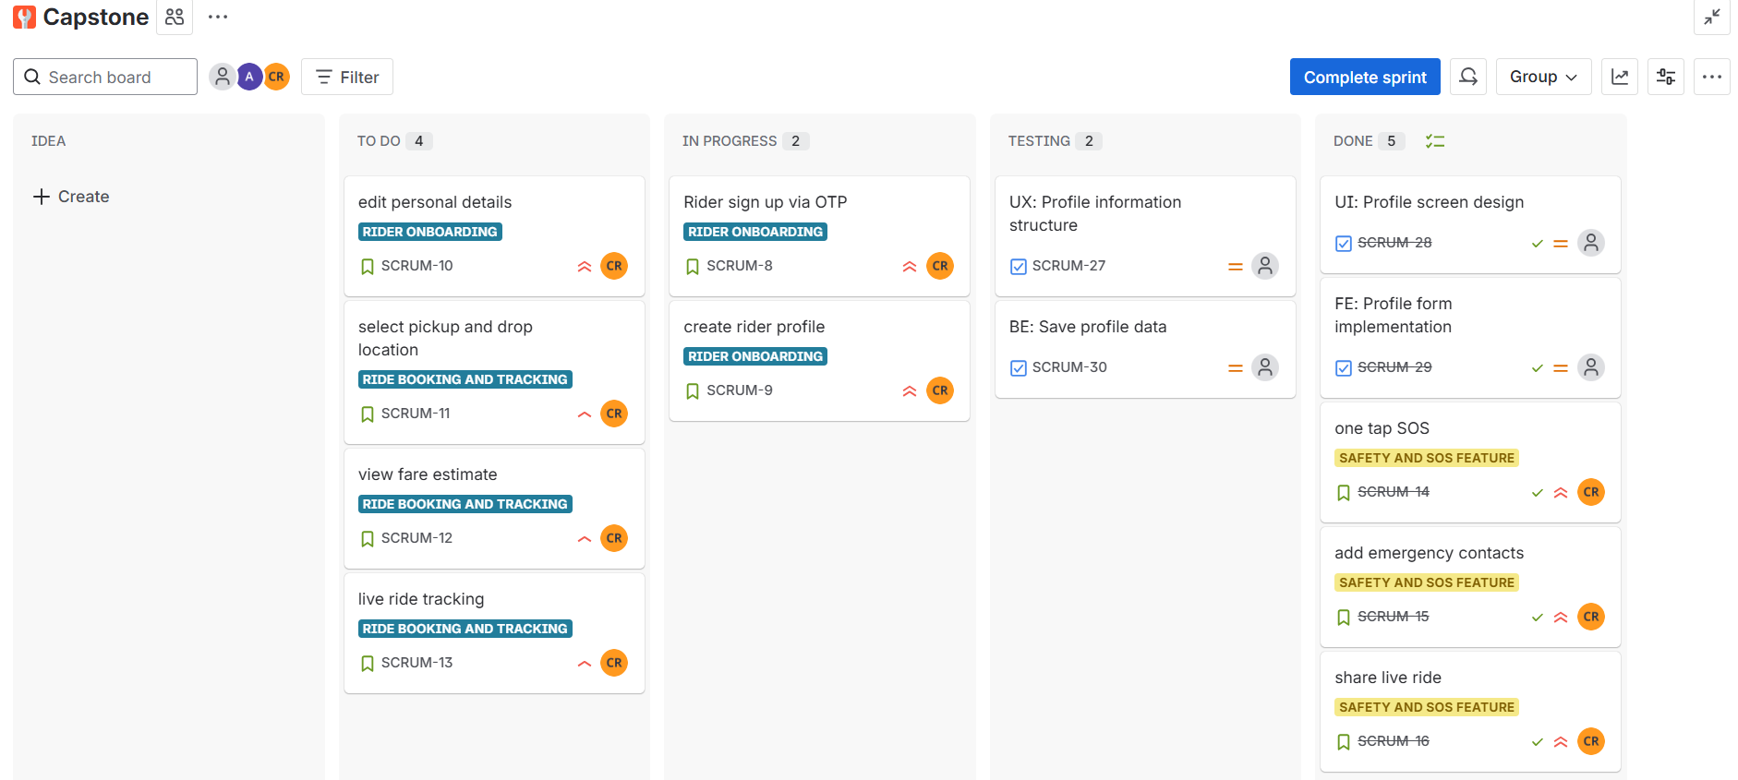
JIRA Integration

Slide 28
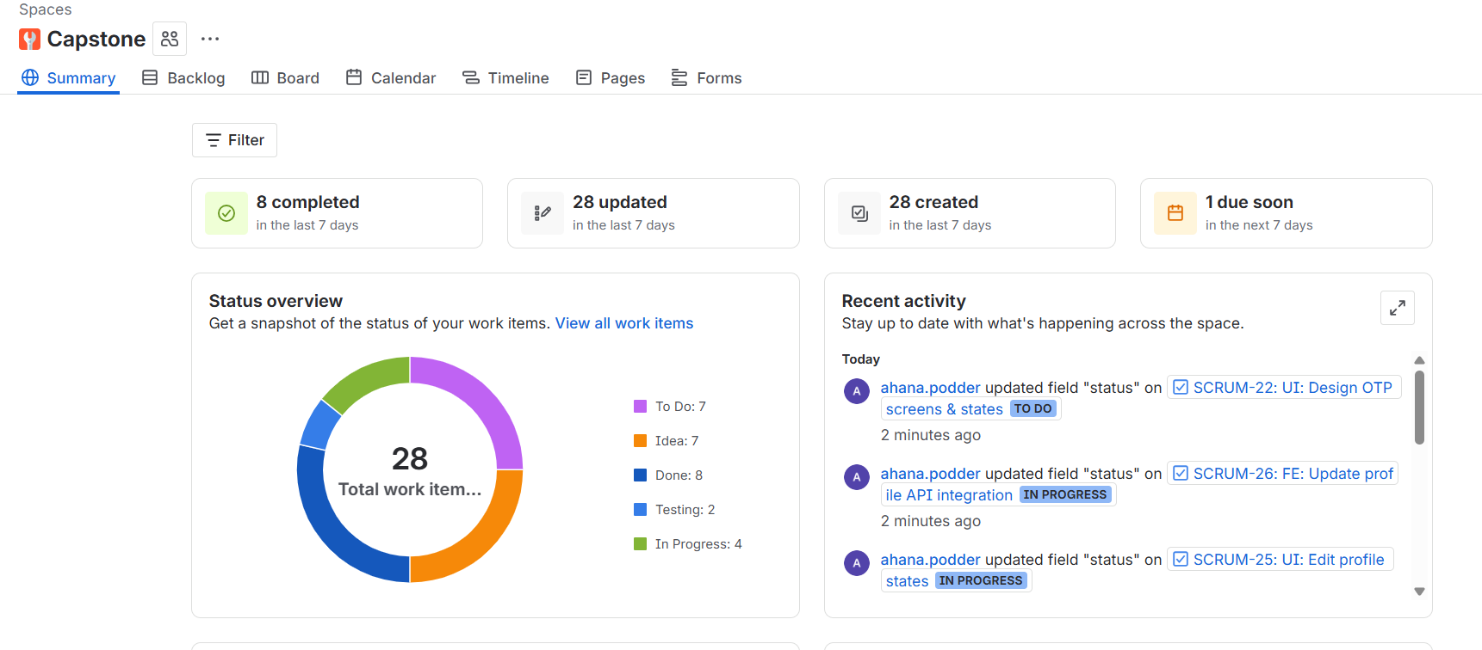
JIRA Integration

Slide 29
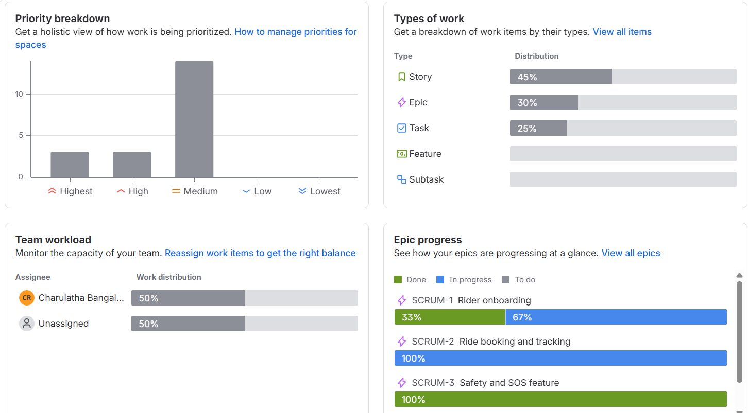
JIRA Integration

Slide 30
Thank you

